Slide 1

Virtual Reality as a Medium: Changing Mechanics
Tom Forsyth
Software Architect, Oculus
June 22nd 2015

Slide 2
Tom Forsyth
Graphics drivers @ 3Dlabs
Game graphics @ Muckyfoot
Urban Chaos
Startopia
Blade 2
Animation middleware: Granny3D @ RAD Game Tools
Instruction set design on Larrabee / Xeon Phi @ intel
VR research @ Valve
VR versions of Team Fortress 2 & Half Life 2
Software Architect @ Oculus
All things graphics
Distortion & calibration, interaction with lens design
Best practices; dev.rel. support; psychology
2

Slide 3
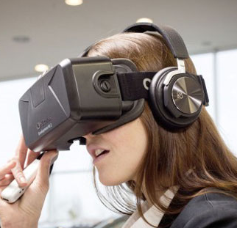
VR is awesome!

Slide 4
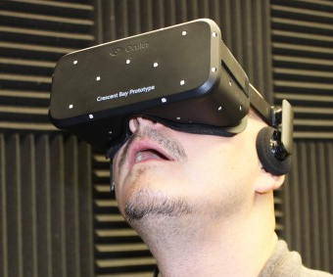
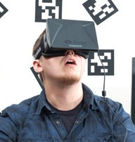
VR is awesome!

Slide 5
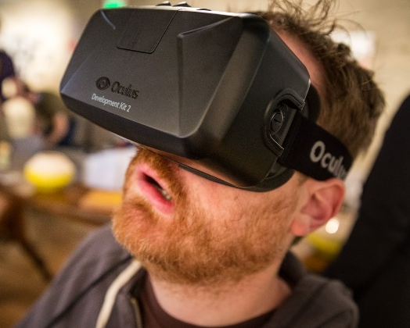
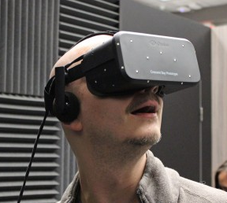
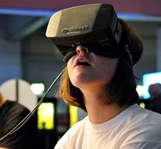
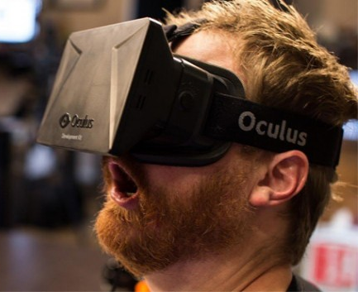
VR is awesome!

Slide 6
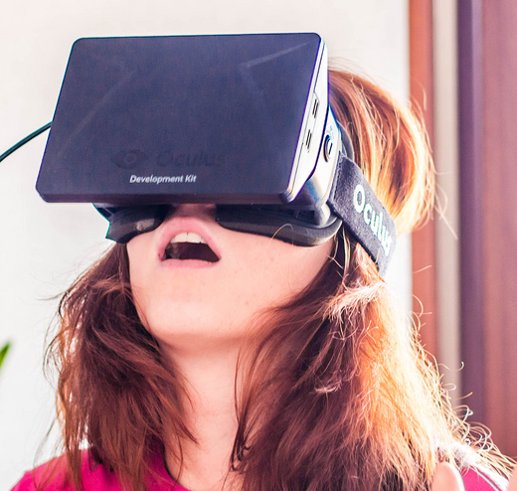
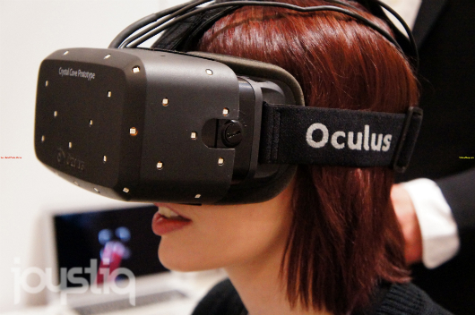
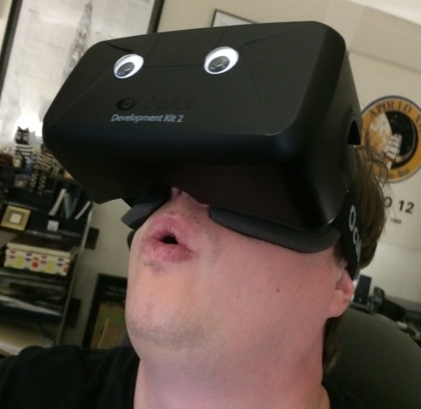
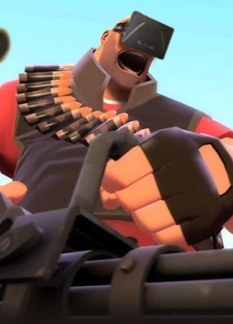
VR is awesome!

Slide 7
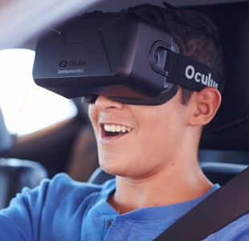
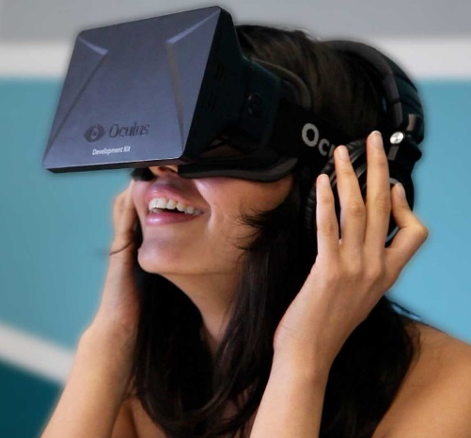
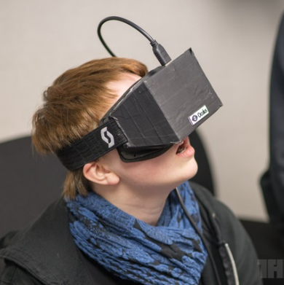
VR is awesome!

Slide 8
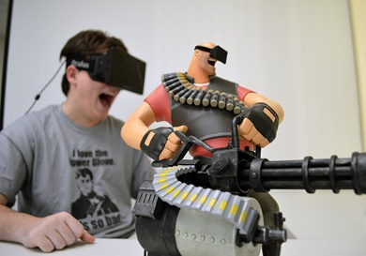
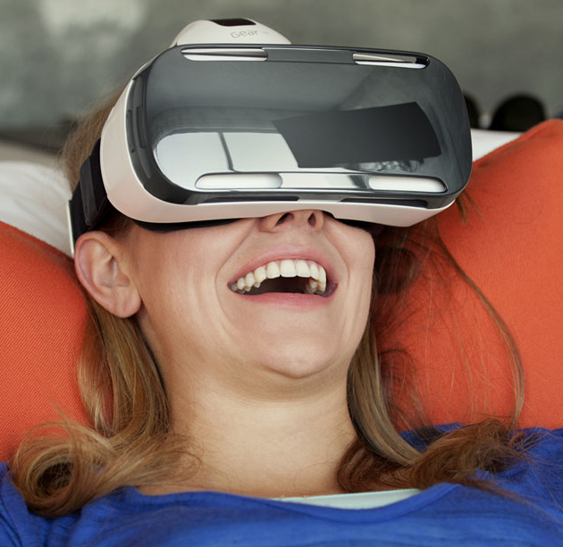
VR is awesome!

Slide 9
VR is awesome!
This is a conference about gameplay, not graphics.
So far, VR has mostly been experiences
or games ported from existing media.
And sure, many of those are AWESOME in VR!

Slide 10
VR is awesome!
This is a conference about gameplay, not graphics.
So far, VR has mostly been experiences
or games ported from existing media.
And sure, many of those are AWESOME in VR!
We have yet to see many truly VR-native titles
So what will they look like?
What are the unique gameplay mechanics that only VR can offer?
4

Slide 11
Topics
Current state of hardware
Game mechanics in the new medium
Experiences to try
Conclusions
5

Slide 12
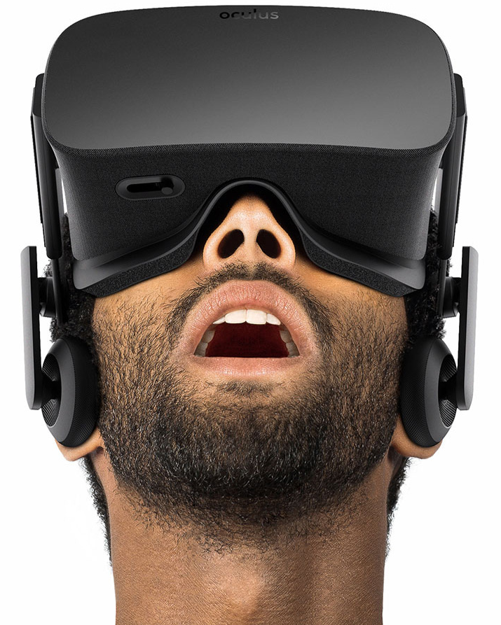
Current state of hardware
Oculus Rift consumer version, early 2016
2160x1200, 90Hz screen
~100 degree stereo FOV

Slide 13

Current state of hardware
Oculus Rift consumer version, early 2016
2160x1200, 90Hz screen
~100 degree stereo FOV
Sensor Fusion tracking
1kHz Inertial Measurement Unit (rotation, acceleration)
External camera watching constellation of LEDs (absolute position)

Slide 14
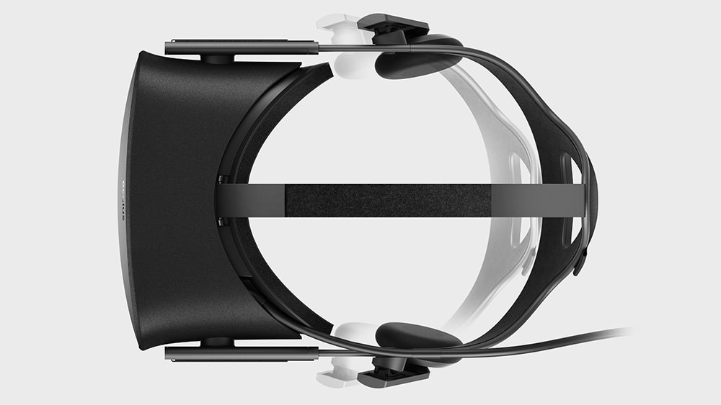
Current state of hardware
Oculus Rift consumer version, early 2016
2160x1200, 90Hz screen
~100 degree stereo FOV
Sensor Fusion tracking
1kHz Inertial Measurement Unit
External camera watching constellation of LEDs
Integrated headphones, calibrated for HRTF/binaural sound

Slide 15
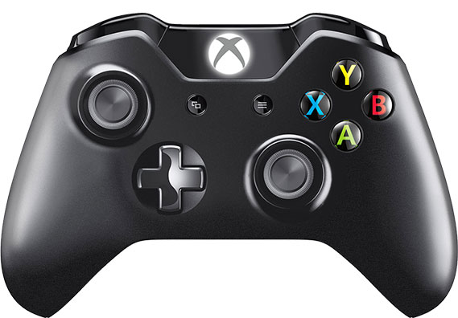
Current state of hardware
Oculus Rift consumer version, early 2016
2160x1200, 90Hz screen
~100 degree stereo FOV
Sensor Fusion tracking
1kHz Inertial Measurement Unit
External camera watching constellation of LEDs
Integrated headphones
Wireless Xbox One gamepad
For more “traditional” games

Slide 16
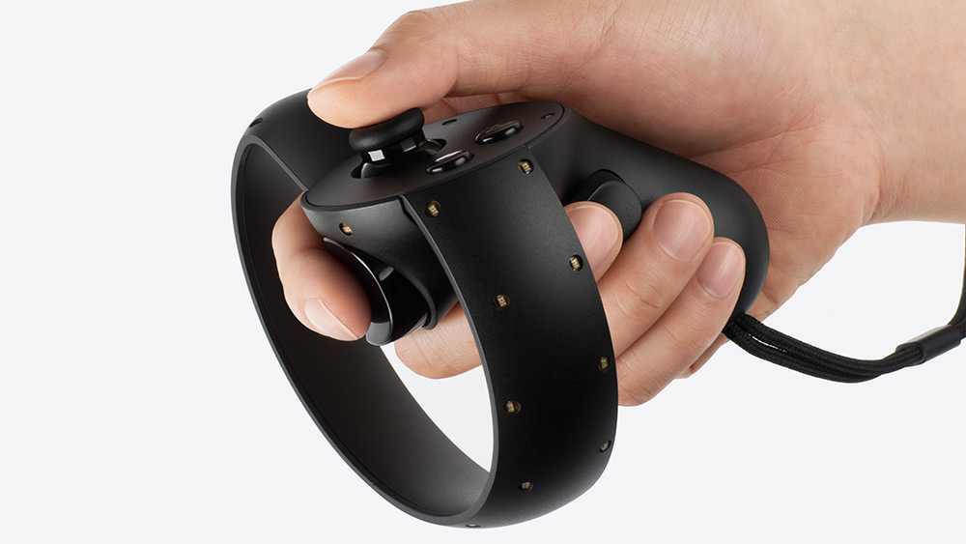
Current state of hardware
Oculus Rift consumer version, early 2016
2160x1200, 90Hz screen
~100 degree stereo FOV
Sensor Fusion tracking
1kHz Inertial Measurement Unit
External camera watching constellation of LEDs
Integrated headphones
Wireless Xbox One gamepad
Oculus Touch wireless tracked controllers
Thumb stick, buttons and triggers
Same tracking system as the HMD
8

Slide 17
Game Mechanics
Movement & locomotion
Less cinematography
Perception of space and scale
Pacing and being kind to your user
Spatial sound
Input methods
9

Slide 18
Movement & locomotion
Fundamentally difficult in VR
Not a “bug” – better technology won’t help
When eyes and ears disagree, people get sick
Eyes say you are running around
Ears say you’re sitting at a desk

Slide 19
Movement & locomotion
Fundamentally difficult in VR
When eyes and ears disagree, people get sick
Be very careful with stairs
Some people have extra big problems
Elevators are (surprisingly) better
No clear solution
Same problem as seasickness, and we haven’t solved that either
Can people get used to it?
Will kids brought up with VR never have the problem?
11

Slide 20
Movement & locomotion
Avoid acceleration
Inner ear senses acceleration, not constant speed
Constant linear motion works well for most people
Instant changes in speed are better than gradual ones (surprising!)

Slide 21
Movement & locomotion
Avoid acceleration
Inner ear senses acceleration, not constant speed
Constant linear motion works well for most people
Instant changes in speed are better than gradual ones (surprising!)
Literal “blink” transitions
Render black borders top and bottom coming together
Do it fast enough and some people don’t even see them!
Combine with teleportation
14

Slide 22
Movement & locomotion
VR rooms
How many people will have one?
Limited useful space
Safety concerns
Treadmills
Don’t actually solve the problem!
Your ears still aren’t actually moving
Motion platforms
Only works for cars & aircraft, and expensive
16

Slide 23
Less cinematography
Much cinematic language vanishes in VR
The camera is the player
Cinematic effects are literally moving the player’s head!
Maybe in time audiences will learn the same detachment?

Slide 24
Less cinematography
Much cinematic language vanishes in VR
Camera rotation
Never
Taking control from the user causes acute nausea

Slide 25
Less cinematography
Much cinematic language vanishes in VR
Camera rotation – no good terribad awful
Camera translation
Use sparingly, if at all
Especially unexpected motion
Try to signal it beforehand

Slide 26
Less cinematography
Much cinematic language vanishes in VR
Camera rotation – no good terribad awful
Camera translation – be very careful
Focus pulls
Of limited use in games already – cutscenes only
Even more annoying in VR
Though not particularly nauseating

Slide 27
Less cinematography
Much cinematic language vanishes in VR
Camera rotation – no good terribad awful
Camera translation – be very careful
Focus pulls – of limited use
Framing
There’s no frame in VR!
Force with a prop e.g. window/door?

Slide 28
Less cinematography
Much cinematic language vanishes in VR
Camera rotation – no good terribad awful
Camera translation – be very careful
Focus pulls – of limited use
Framing – needs a prop
High/low camera angles
Implies player is crouching or flying
Low angles especially feel really odd
Player is probably not focused on what you’re trying to say with the angle!

Slide 29
Less cinematography
Much cinematic language vanishes in VR
Camera rotation – no good terribad awful
Camera translation – be very careful
Focus pulls – of limited use
Framing – needs a prop
High/low camera angles – player contortions
Cuts
Many fast cuts cause disorientation
Consider using “blink” cuts
22

Slide 30
Perception of space and scale

Slide 31

Perception of space and scale
Inter-Pupillary Distance (IPD) provides a yardstick
Also size of head/neck motion

Slide 32
Perception of space and scale
Inter-Pupillary Distance (IPD) provides a yardstick
Inter-Camera Distance (ICD) determines scale of the virtual world
Changing ICD makes the world larger or smaller
Must scale neck motion the same amount or you get nausea
It is NOT good at making the user feel taller or shorter
25

Slide 33
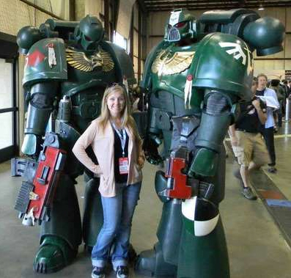
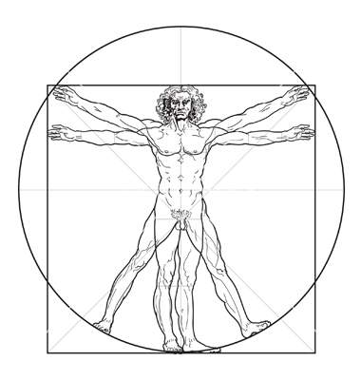
Perception of space and scale
Example – WH40k Space Marines are ~8 feet tall

Slide 34
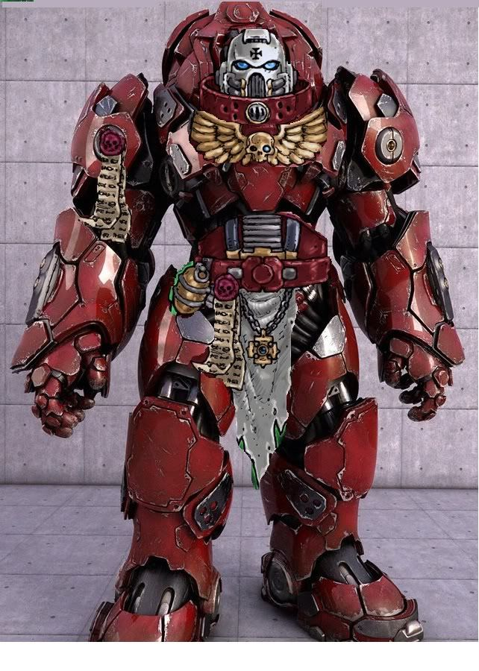
Perception of space and scale
Average human IPD is around 65mm
So by math, Space Marine’s IPD is probably around 90mm?

Slide 35
Perception of space and scale
But if you move the virtual cameras to 90mm, you don’t feel big!
Instead, the world feels small

Slide 36
Perception of space and scale
So instead of feeling huge…

Slide 37
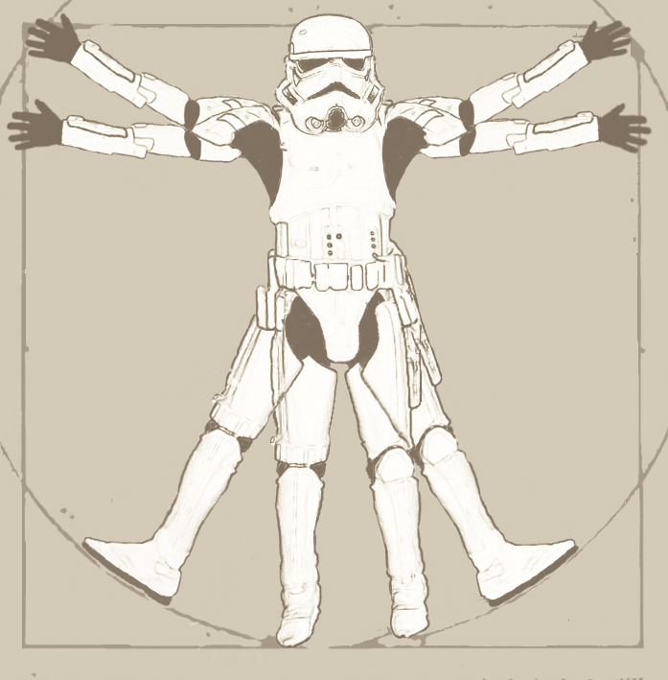
Perception of space and scale
So instead of feeling huge…
You just feel like yourself in a suit

Slide 38
Perception of space and scale
Instead, keep your own IPD
And stick that head 8 foot up
27

Slide 39
Perception of space and scale
Inter-Pupillary Distance (IPD) provides a yardstick
Inter-Camera Distance (ICD) determines scale of the virtual world
Scale neck motion the same amount
Moving the cameras higher or lower off the ground works
People feel taller or shorter
Useful when playing children, yeti, giant robots, etc
Or playing known characters, e.g. James Bond, Bilbo Baggins, Godzilla

Slide 40
Perception of space and scale
Inter-Pupillary Distance (IPD) provides a yardstick
Inter-Camera Distance (ICD) determines scale of the virtual world
Scale neck motion the same amount
Moving the cameras higher or lower off the ground works
People feel taller or shorter
Useful when playing children, yeti, giant robots, etc
Or playing known characters
What does this mean for motion controls?
Swords/guns/equipment
29

Slide 41
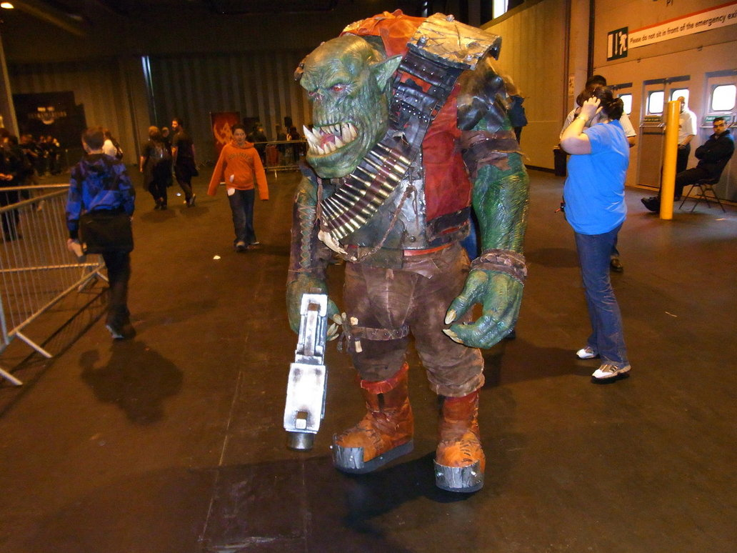
Perception of space and scale
Large people/creatures are viscerally intimidating

Slide 42

Perception of space and scale
Large people/creatures are viscerally intimidating
Growing the player to match makes things feel “epic”

Slide 43
Perception of space and scale
Large people/creatures are viscerally intimidating
Growing the player to match makes things feel “epic”
Dangerous objects
Heavy masses hanging overhead
Fast-moving rocks/machinery/robots nearby

Slide 44
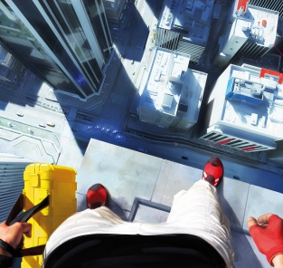
Perception of space and scale
Large people/creatures are viscerally intimidating
Growing the player to match makes things feel “epic”
Dangerous objects
Heavy masses hanging overhead
Fast-moving rocks/machinery/robots nearby
You can invoke primal fears
Falling a long way, or onto dangerous surfaces
Tight spaces
Submersion
But beware of those with real phobias
33

Slide 45
Pacing and being kind to your user
VR is highly involving and emotive
It demands your attention
Maintaining emotional distance is hard
Usual external distractions (drinks, family, internet) often missing/masked

Slide 46

Pacing and being kind to your user
VR is highly involving and emotive
It demands your attention
Maintaining emotional distance is hard
Usual external distractions (drinks, family, internet) often missing/masked
Full-pace VR can be very draining
Team Fortress 2 VR is technically sound
But it’s terrifying to play!

Slide 47
Pacing and being kind to your user
VR is highly involving and emotive
It demands your attention
Maintaining emotional distance is hard
Usual external distractions (drinks, family, internet) often missing/masked
Full-pace VR can be very draining
Use pacing techniques from cinema
Similarly captive audience
We expect similar play times in VR

Slide 48
Pacing and being kind to your user
VR is highly involving and emotive
It demands your attention
Maintaining emotional distance is hard
Usual external distractions (drinks, family, internet) often missing/masked
Full-pace VR can be very draining
Use pacing techniques from cinema
Similarly captive audience
We expect similar play times in VR
Where possible, allow players to progress at their own pace
Although removing that control can also be a useful dramatic tool!
36

Slide 49
Spatial sound
“Creates a totally immersive, realistic audio experience […] it will enhance player's audio/visual game play experience.
It provides additional audio sources and includes the ability to mimic real-world environments with reflections and occlusions […] This will take the immersive audio experience to new heights.”

Slide 50
Spatial sound
“Creates a totally immersive, realistic audio experience […] it will enhance player's audio/visual game play experience.
It provides additional audio sources and includes the ability to mimic real-world environments with reflections and occlusions […] This will take the immersive audio experience to new heights.”
Epic Games press release, Aureal A3D technology, 1998
40

Slide 51
Spatial sound
Great spatial sound tech has been around for a long time
But most users do not have a well set-up system
Significant numbers have left and right swapped!
Sound designers cannot rely on good spatial awareness

Slide 52

Spatial sound
Great spatial sound tech has been around for a long time
But most users do not have a well set-up system
Significant numbers have left and right swapped!
Sound designers cannot rely on good spatial awareness
With VR, we finally have progress
Reliable hardware – stereo headphones can be assumed
Rift has speakers with known frequency response
Known head position – HRTF can actually work well
Spatial sound built into many VR SDKs

Slide 53
Spatial sound
Great spatial sound tech has been around for a long time
But most users do not have a well set-up system
Significant numbers have left and right swapped!
Sound designers cannot rely on good spatial awareness
With VR, we finally have progress
Reliable hardware – stereo headphones can be assumed
Rift has speakers with known frequency response
Known head position – HRTF can actually work well
Spatial sound built into many VR SDKs
Maybe now can it actually be a game mechanic?

Slide 54
Input methods
Most VR companies have “wands”
Oculus Touch, Sony Move
Valve Vive, Sixsense STEM
Position + orientation of palm
Sticks, buttons and triggers

Slide 55
Input methods
Most VR companies have “wands”
Oculus Touch, Sony Move
Valve Vive, Sixsense STEM
Position + orientation of palm
Sticks, buttons and triggers
Some have “grip” sensors
Users find “grab and hold” a very natural action
Sculpting user-generated content is very compelling in VR
Gestures – “over there”, “follow me”, etc
Low weight and no haptics means swords, climbing, etc is harder
42

Slide 56
Input methods
Conventional game controllers
Still very useful when you need lots of buttons
Good for third-person action games
Surprisingly compelling in VR
Wheels & flightsticks

Slide 57
Input methods
Conventional game controllers
Still very useful when you need lots of buttons
Good for third-person action games
Surprisingly compelling in VR
Wheels & flightsticks
Hand tracking
Limited input channels
Orientation of palm
~10 gestures, imprecise and slow
Actually worse than a wand!
Without haptics, fine control is hard
44

Slide 58
Try these VR experiences…
So you want to try some VR…

Slide 59

Try these VR experiences…
Elite Dangerous
Spaceflight is amazing in VR
Highly polished game
Excellent VR integration

Slide 60
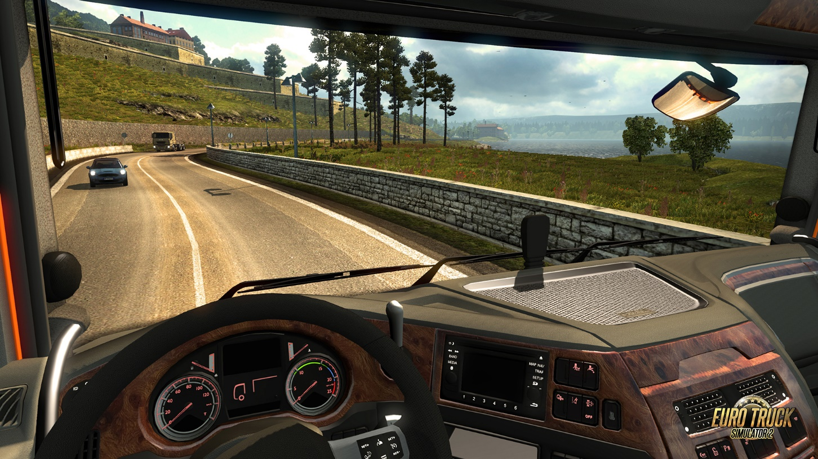
Try these VR experiences…
Elite Dangerous
Euro Truck Simulator 2
Delivering goods in Europe
Curiously compelling
VR completes the zen

Slide 61
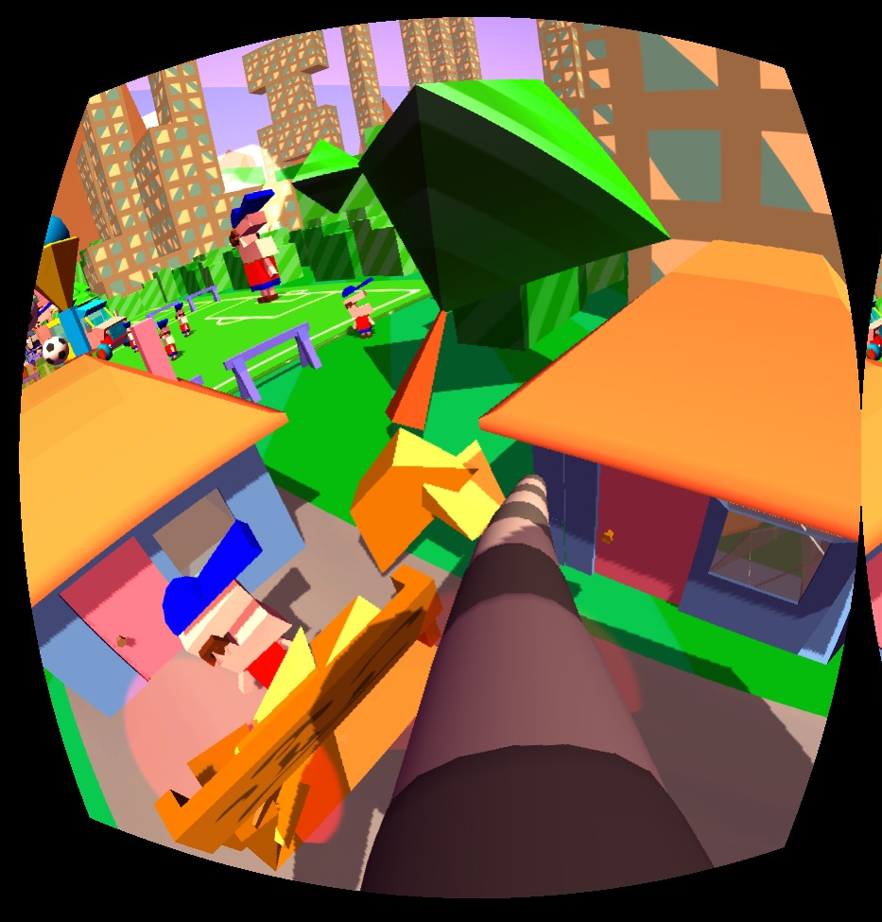
Try these VR experiences…
Elite Dangerous
Euro Truck Simulator 2
Dumpy, Going Elephants
Smash things with your trunk!
Novel input scheme
Gets people looking around

Slide 62
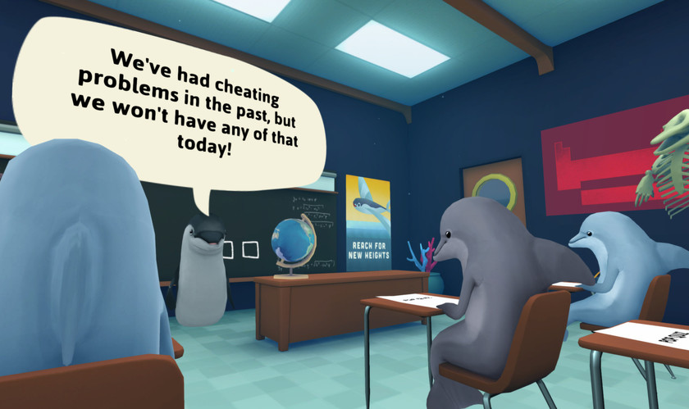
Try these VR experiences…
Elite Dangerous
Euro Truck Simulator 2
Dumpy, Going Elephants
Classroom Aquatic
Cheat to pass the test
Sneak looks at other desks
But don’t get caught!

Slide 63
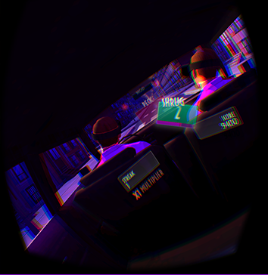
Try these VR experiences…
Elite Dangerous
Euro Truck Simulator 2
Dumpy, Going Elephants
Classroom Aquatic
A Night at the Roculus
Nod/shake your head to the beat
49

Slide 64
Conclusions

Slide 65
Conclusions
VR can be very personal
Immediate sense of being there – “presence”
Scale is conveyed very intuitively
Implicit emotional attachment
Can be a blessing and a curse

Slide 66
Conclusions
VR can be very personal
Immediate sense of being there – “presence”
Scale is conveyed very intuitively
Implicit emotional attachment
Can be a blessing and a curse
Most cinematic tricks don’t work well
Will audiences become more sophisticated in future?

Slide 67
Conclusions
VR can be very personal
Immediate sense of being there – “presence”
Scale is conveyed very intuitively
Implicit emotional attachment
Can be a blessing and a curse
Most cinematic tricks don’t work well
Will audiences become more sophisticated in future?
More expressive inputs
Or will they go the way of the Wiimote?

Slide 68
Conclusions
VR can be very personal
Immediate sense of being there – “presence”
Scale is conveyed very intuitively
Implicit emotional attachment
Can be a blessing and a curse
Most cinematic tricks don’t work well
Will audiences become more sophisticated in future?
More expressive inputs
Or will they go the way of the Wiimote?
Still looking for the “unique killer app” that forces people to get VR
55

Slide 69


Questions?
developer.oculus.com
tom.forsyth@oculus.com
Further reading
Oculus dev area: Best Practices Guide
GDC / Connect 2014: Developing VR Experiences with the Oculus Rift

